Slide 1
Vascular foramina in sauropod vertebrae

Slide 2
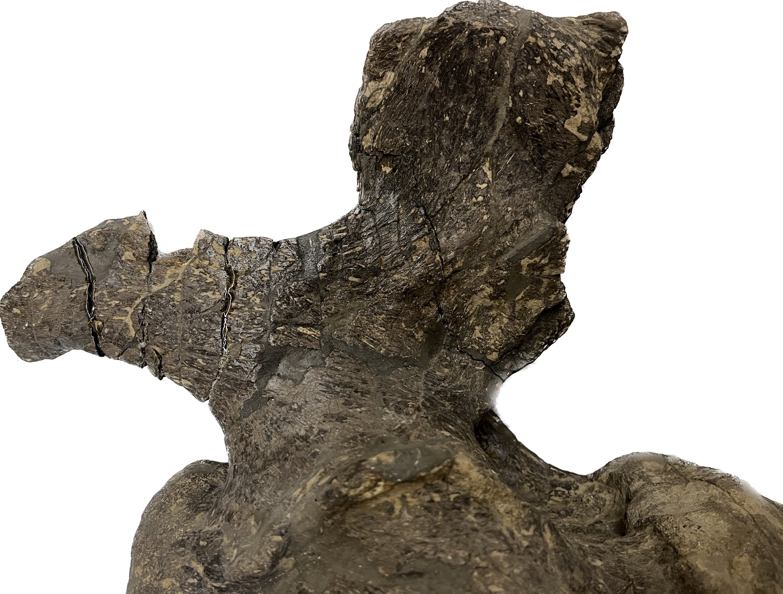
Lateral neural spine
Alamosaurus
USNM 15560 Cd7

Slide 3
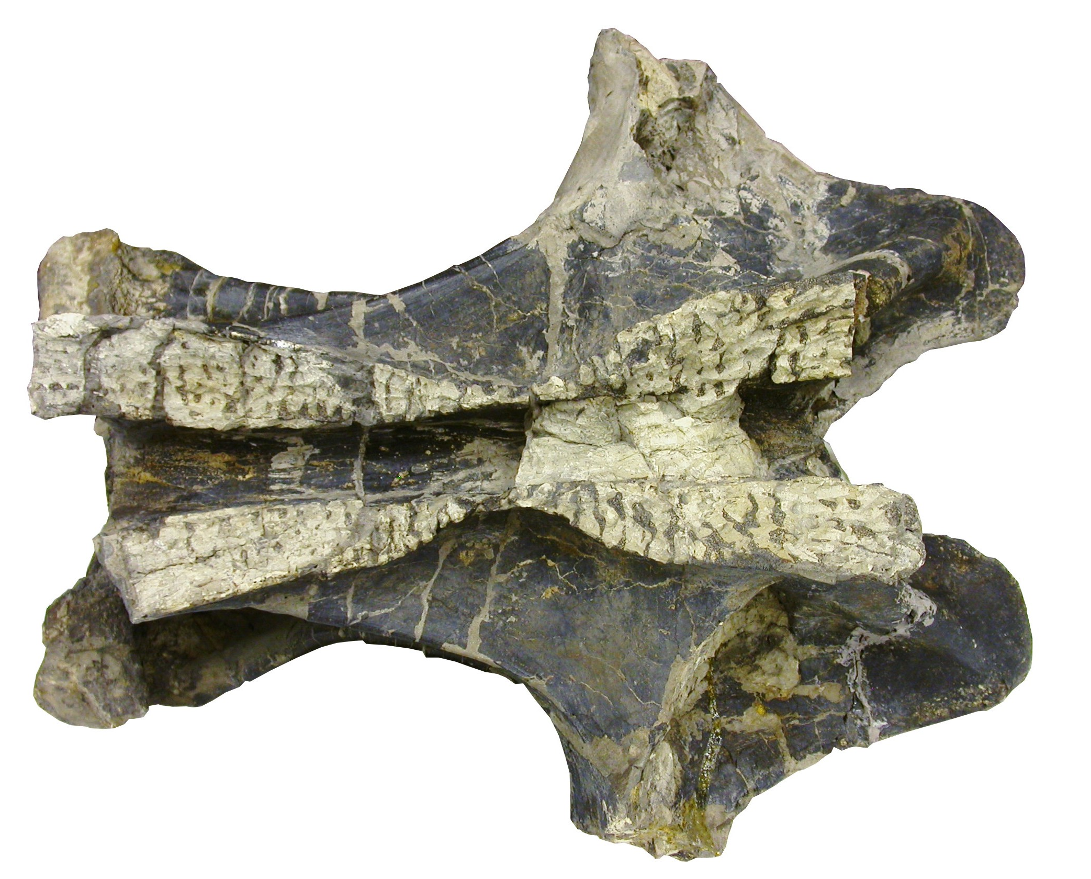
Neural canal ceiling
Brontosaurus
CM 555 C6

Slide 4
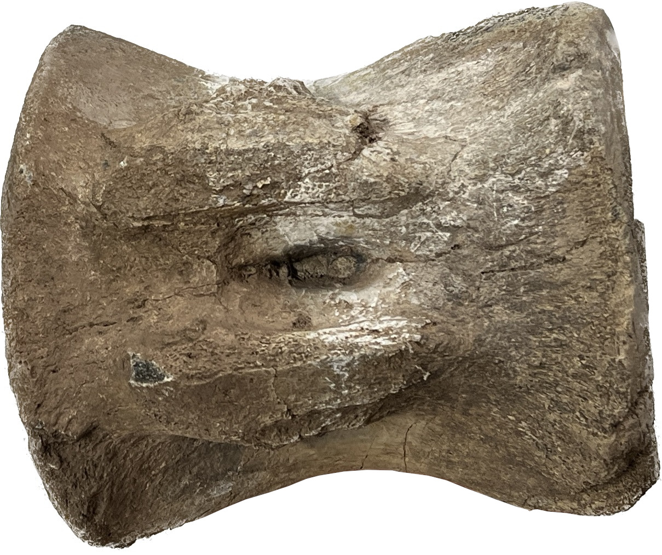
Neural canal floor
Camarasaurus
FHPR 13443 Cd?

Slide 5
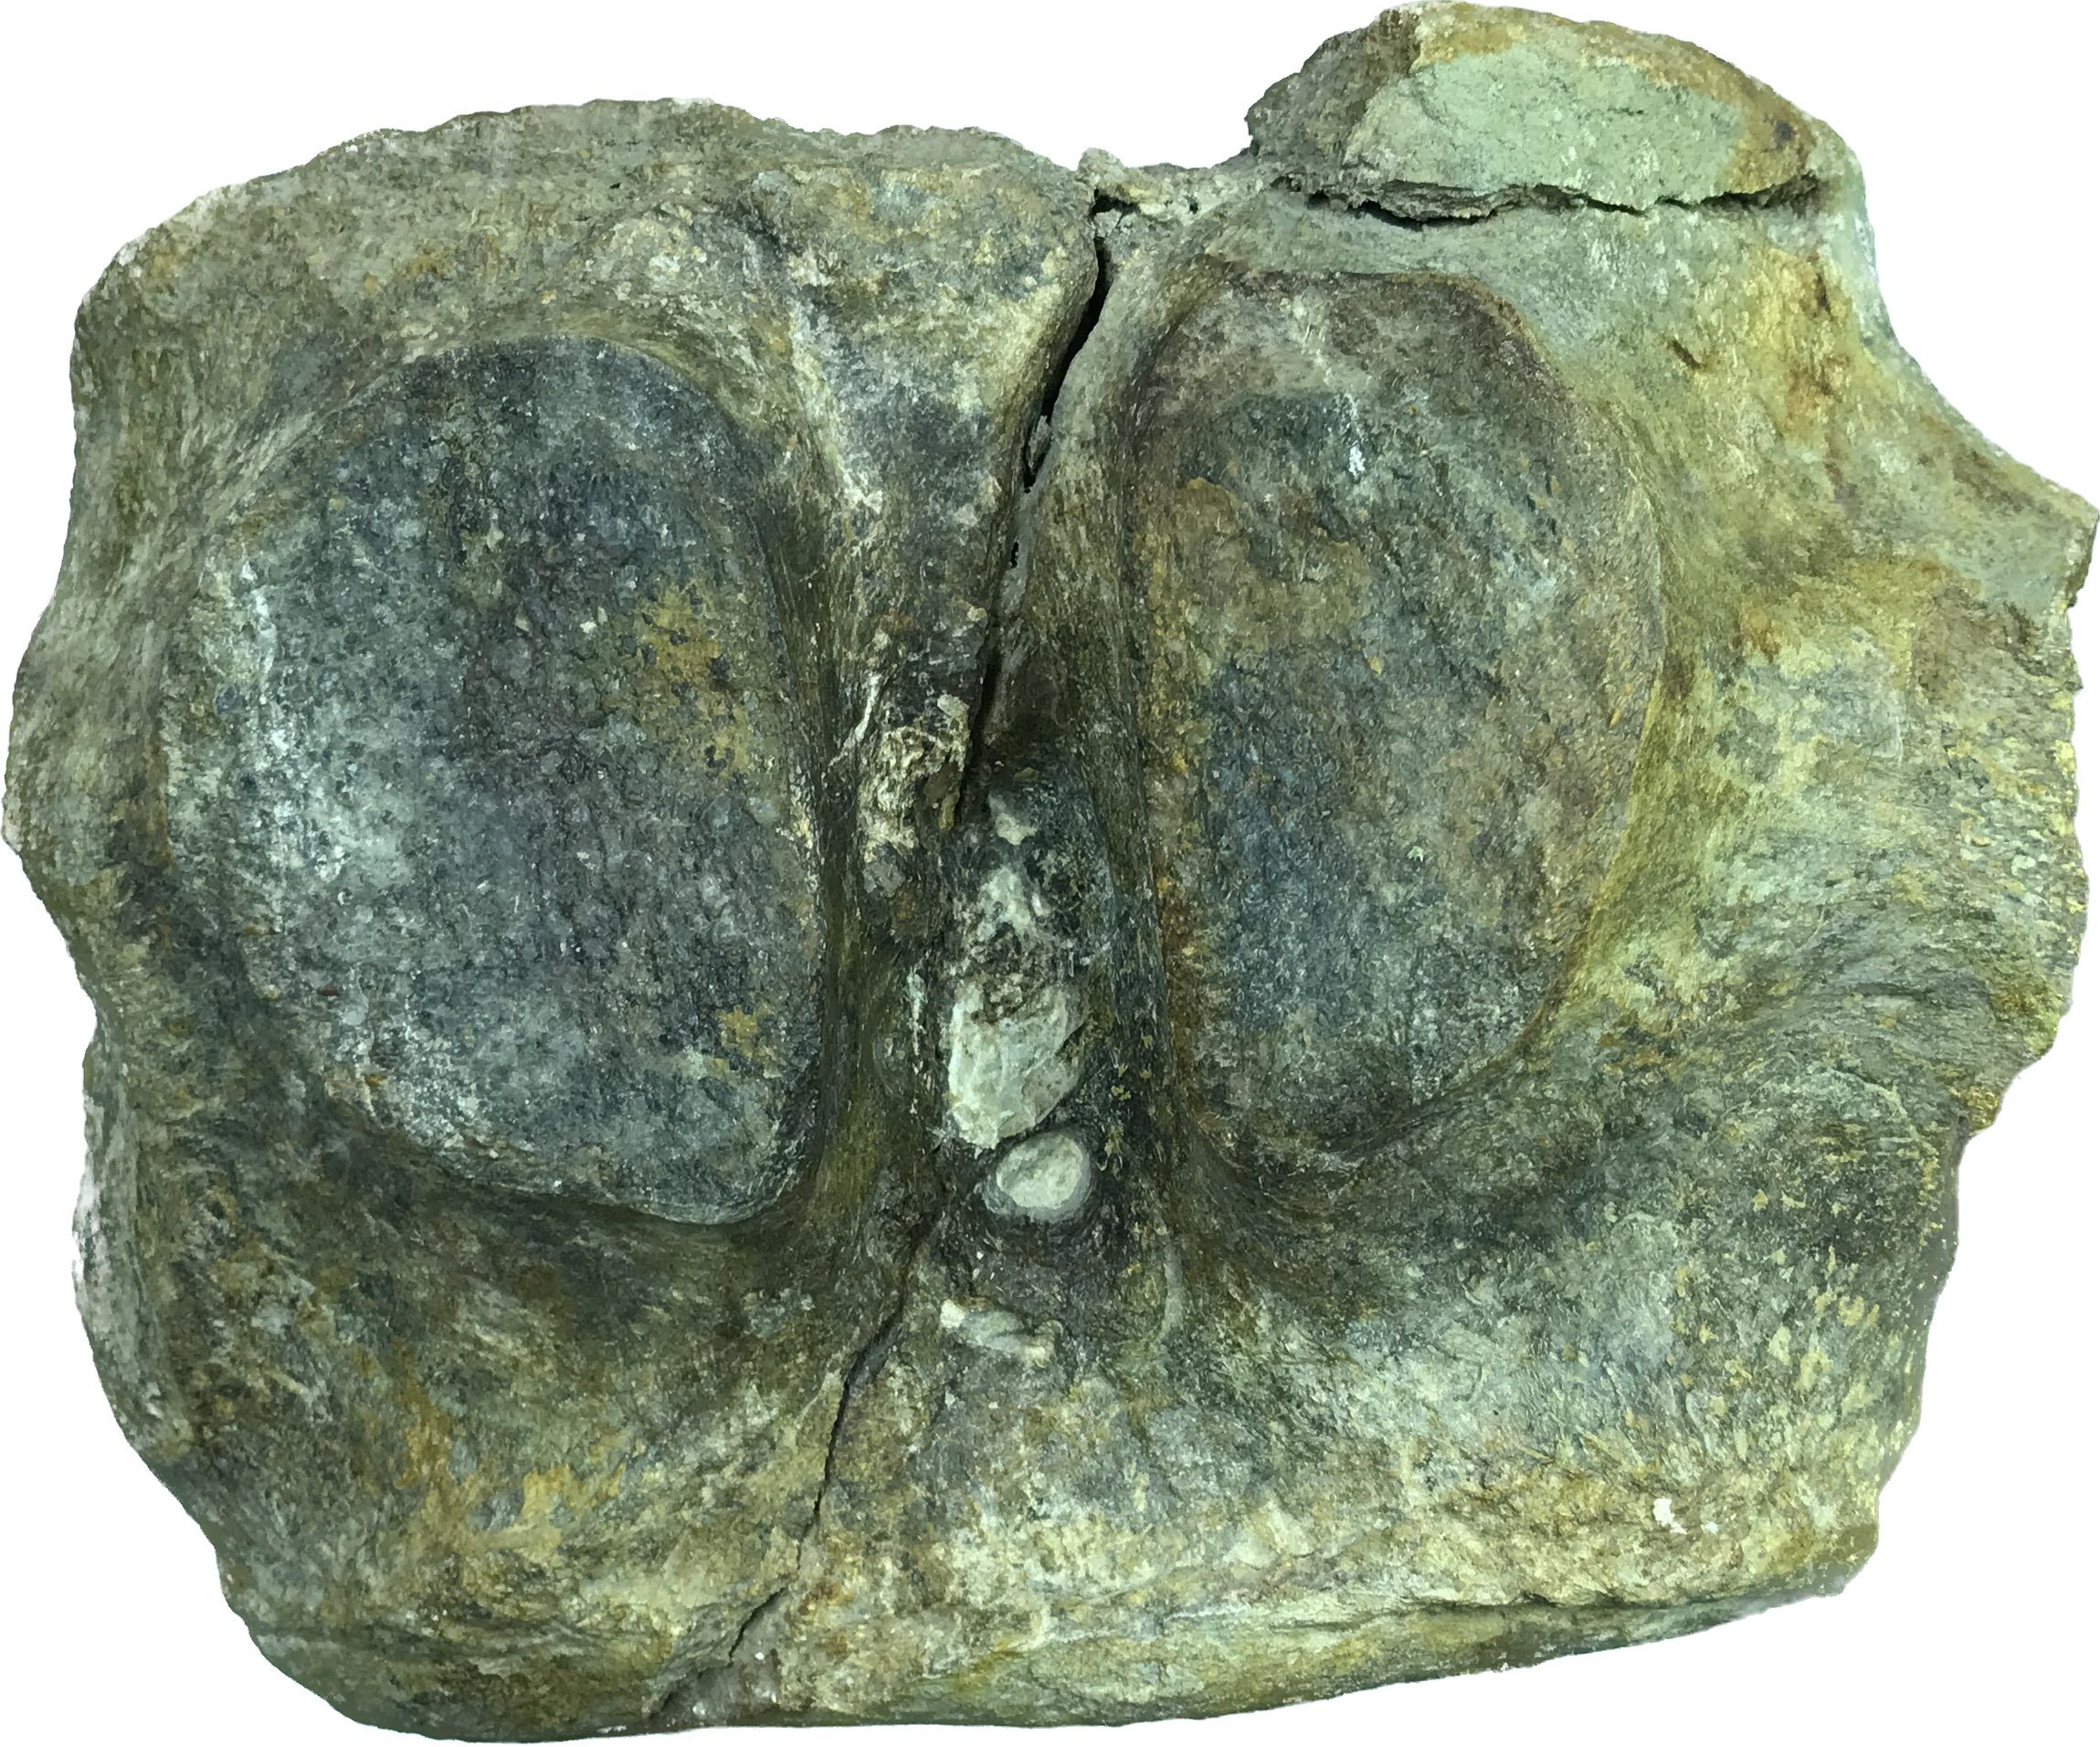
Neural canal floor
Apatosaurus
MWC 5140 Cd?

Slide 6
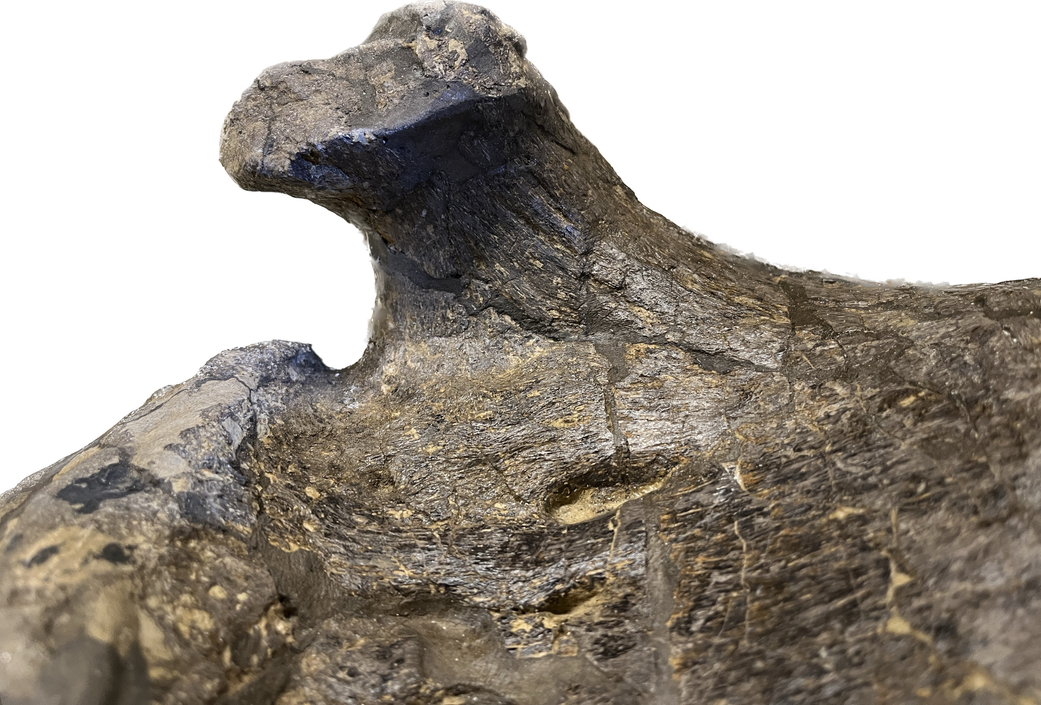
Ventral surface of transverse process
Alamosaurus
USNM 15560 Cd3

Slide 7
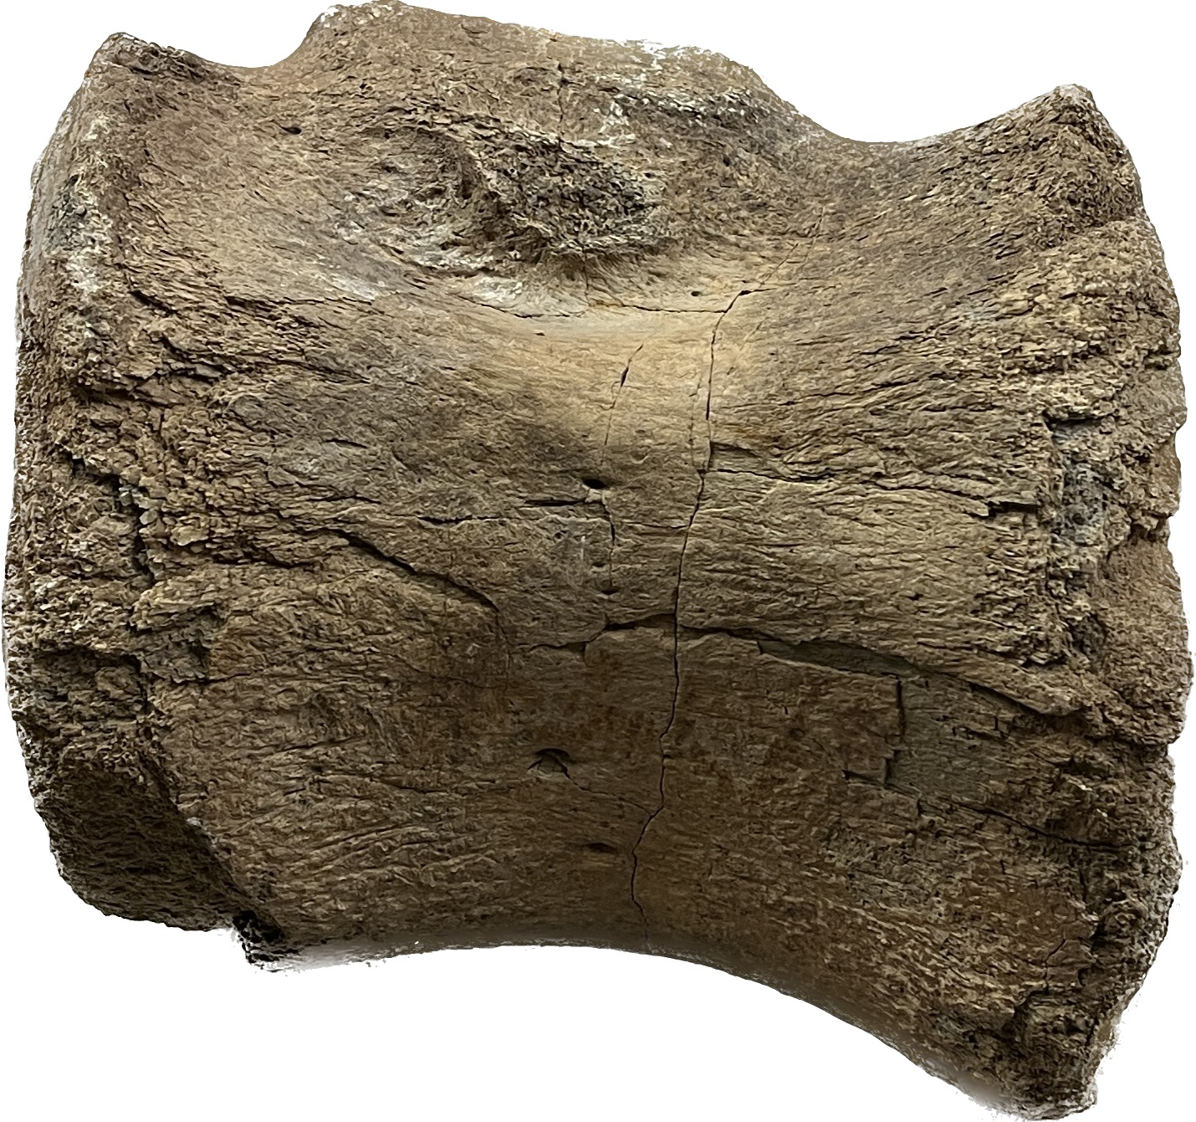
Lateral centrum
Camarasaurus
FHPR 13443 Cd?

Slide 8
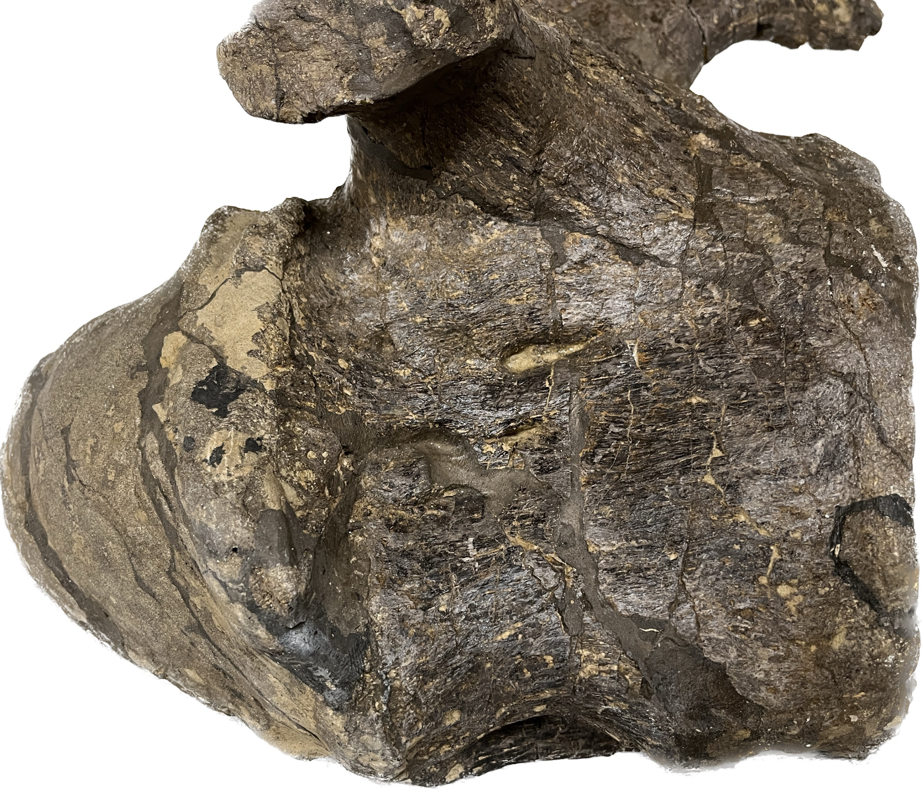
Lateral centrum
Alamosaurus
USNM 15560 Cd3

Slide 9
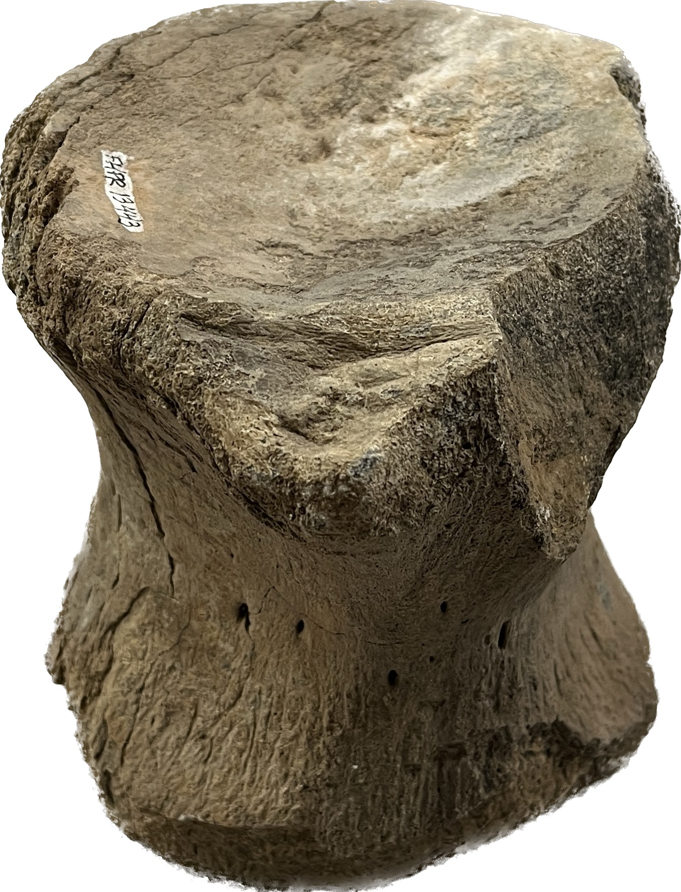
Ventral centrum
Camarasaurus
FHPR 13443 Cd?

Slide 10
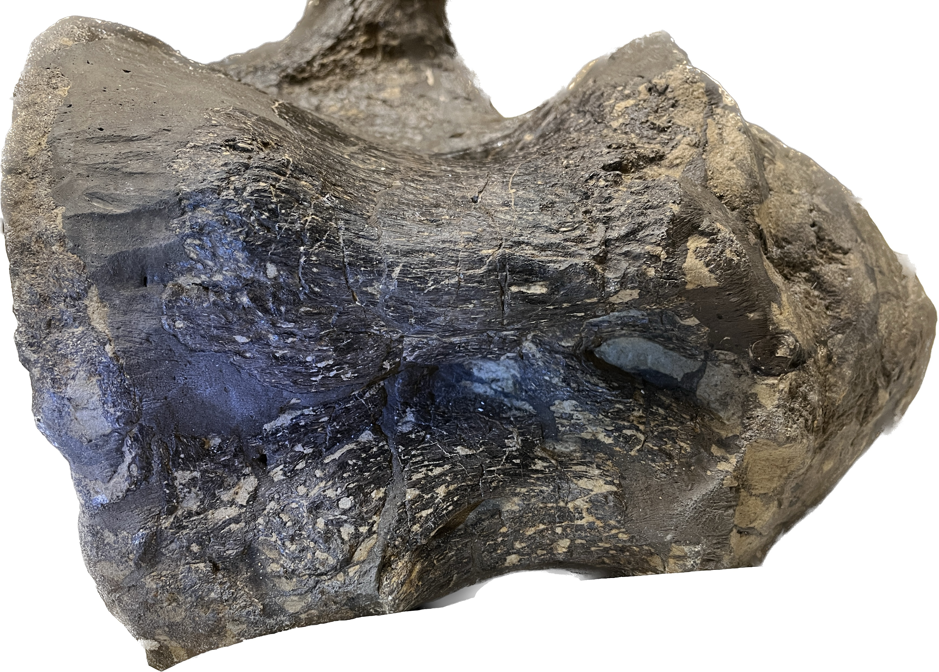
Ventral centrum
Alamosaurus
USNM 15560 Cd3

Slide 11
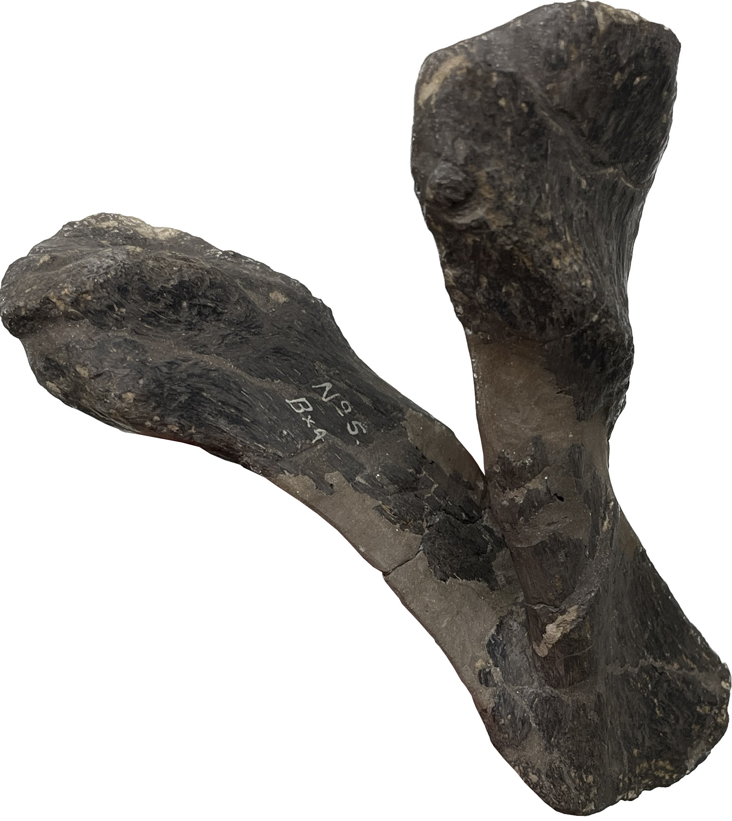
Medial surface of chevron
Alamosaurus
USNM 15560 Cd?

